Slide 1
Cellular Modeling V1
Daniel Chen

Slide 5
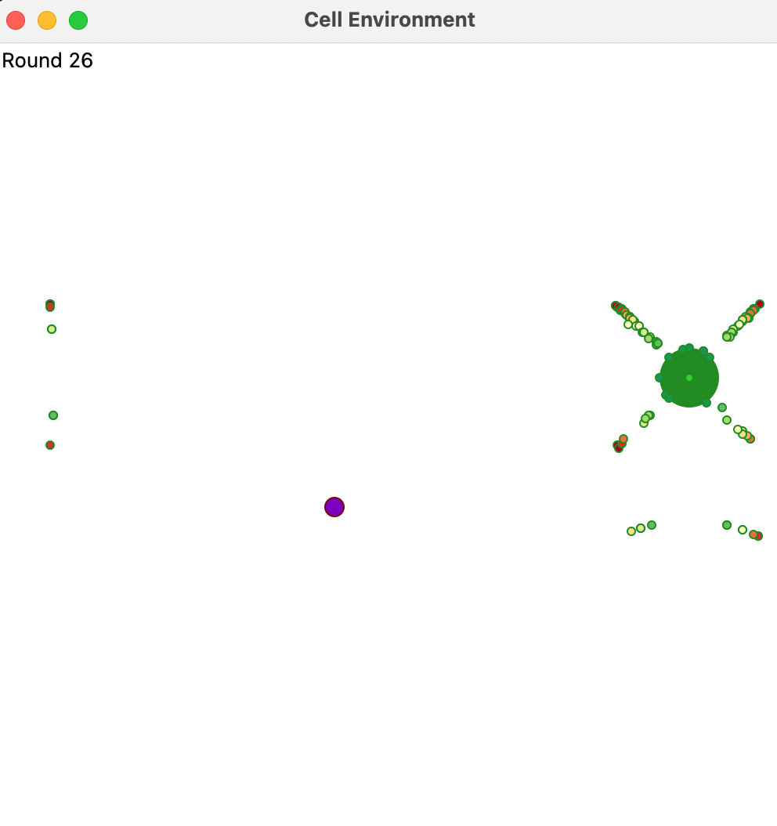

Slide 6
Appendix

Slide 7
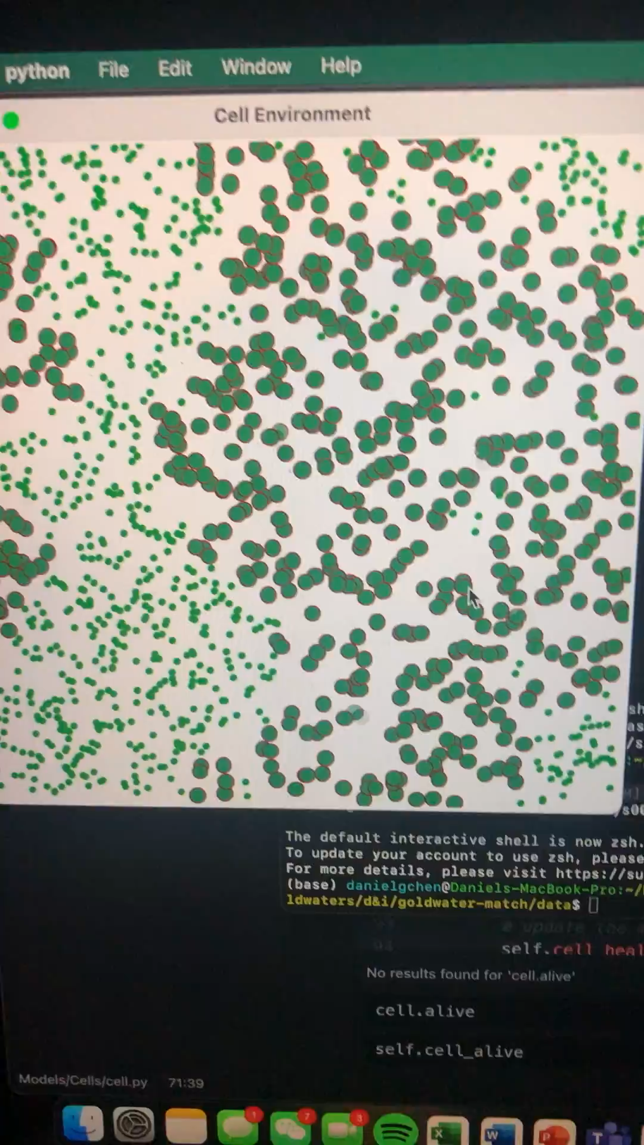
Video of a mono-cell population where food is generated from a random basis

Slide 8
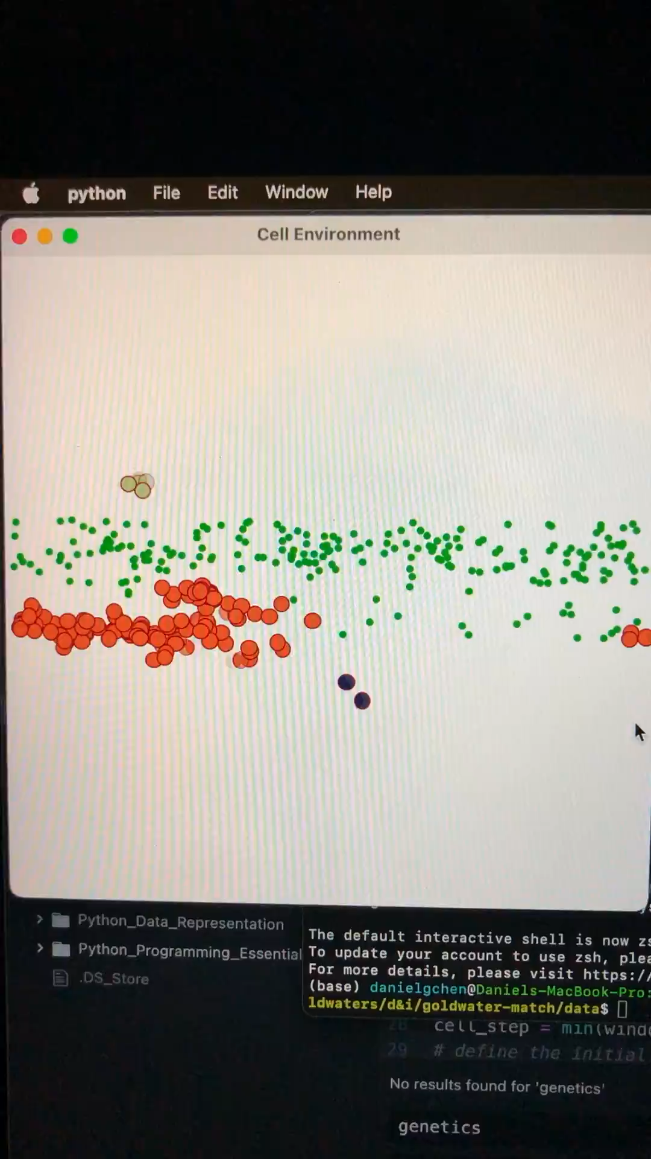
Cells moving in a continuous line, I believe this was before pausing was introduced as a feature and food is generated as a horizontal strip

Slide 9
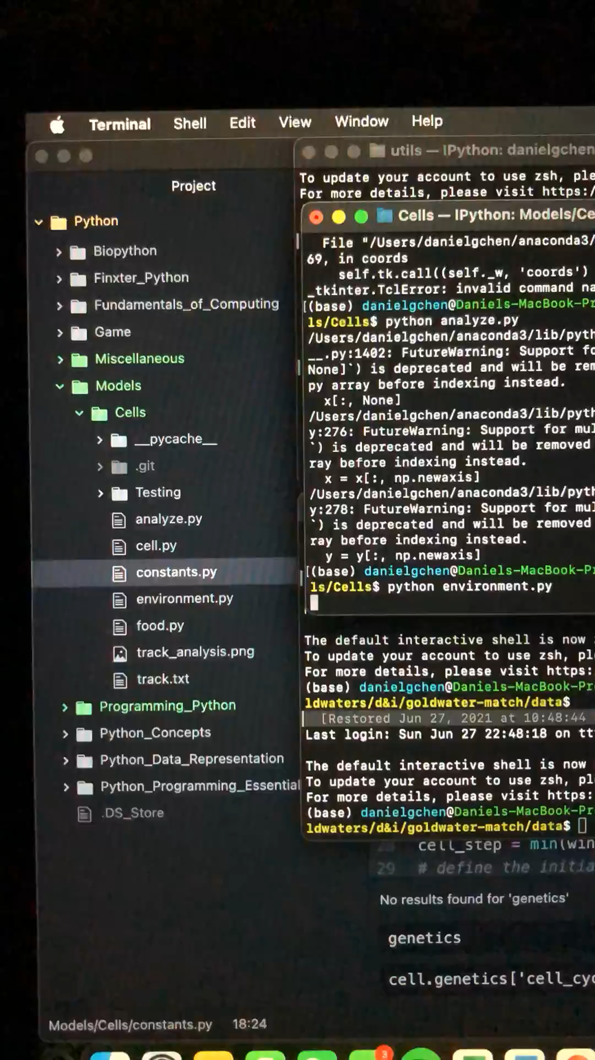
Cells could really only move in one direction here and I wanted to fix this later on

Slide 10
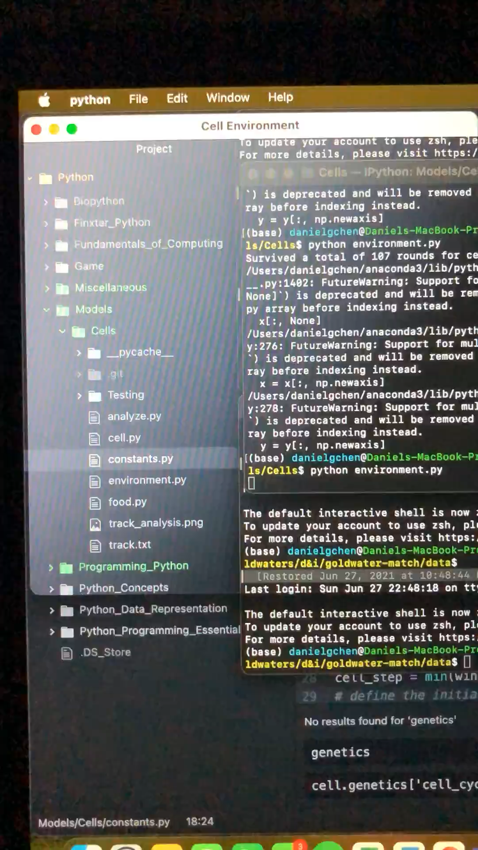
More random movement but one direction

Slide 11
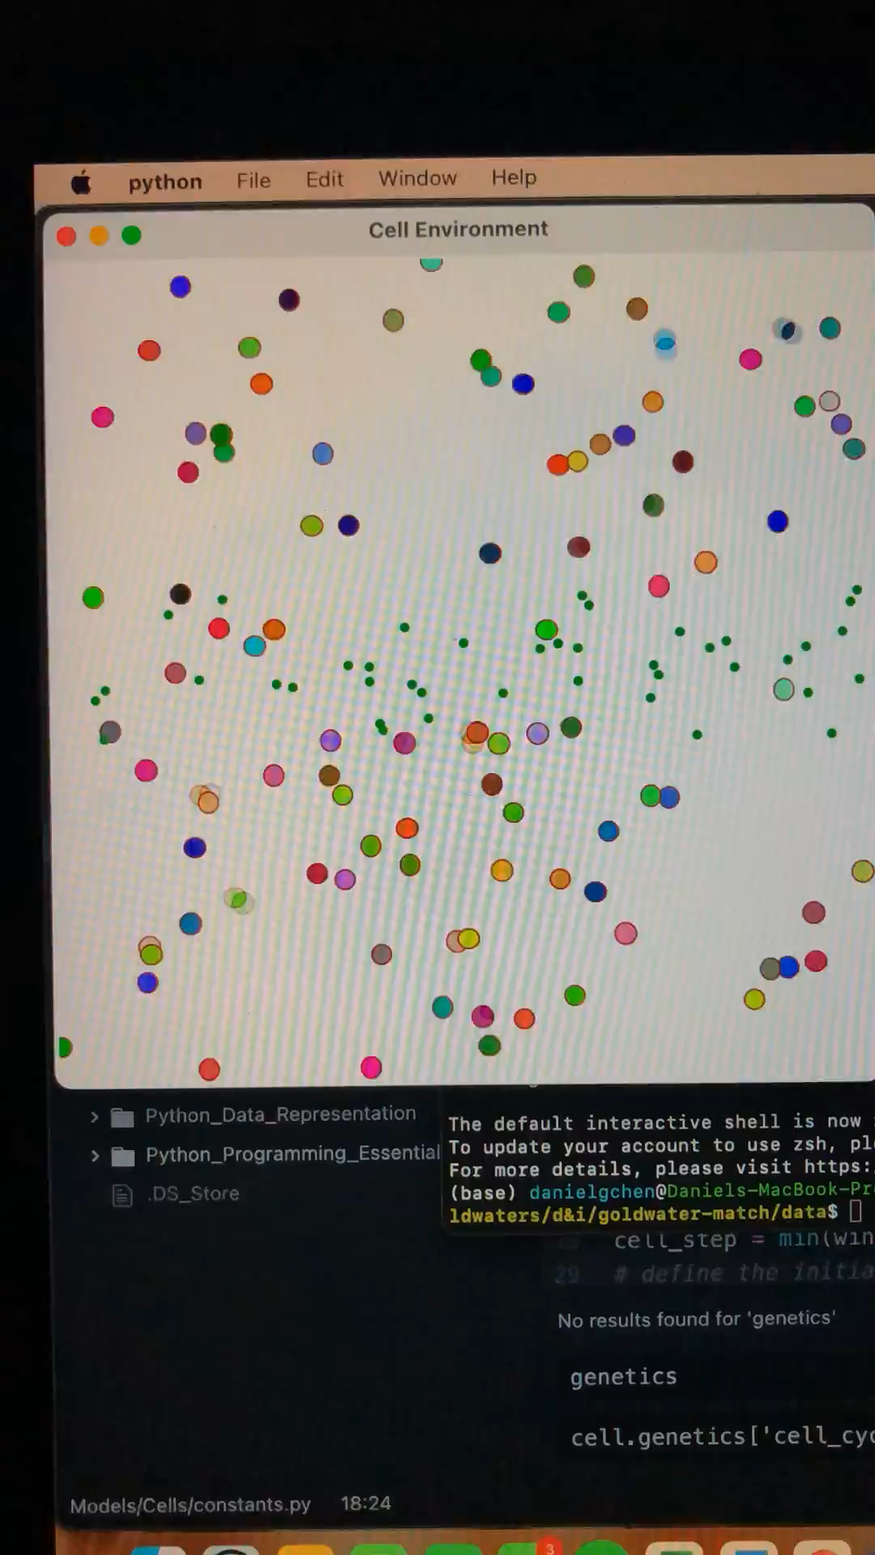
More videos basically I moved away from this because the cells were not developing any smart behaviors they were just by random chance

Slide 12
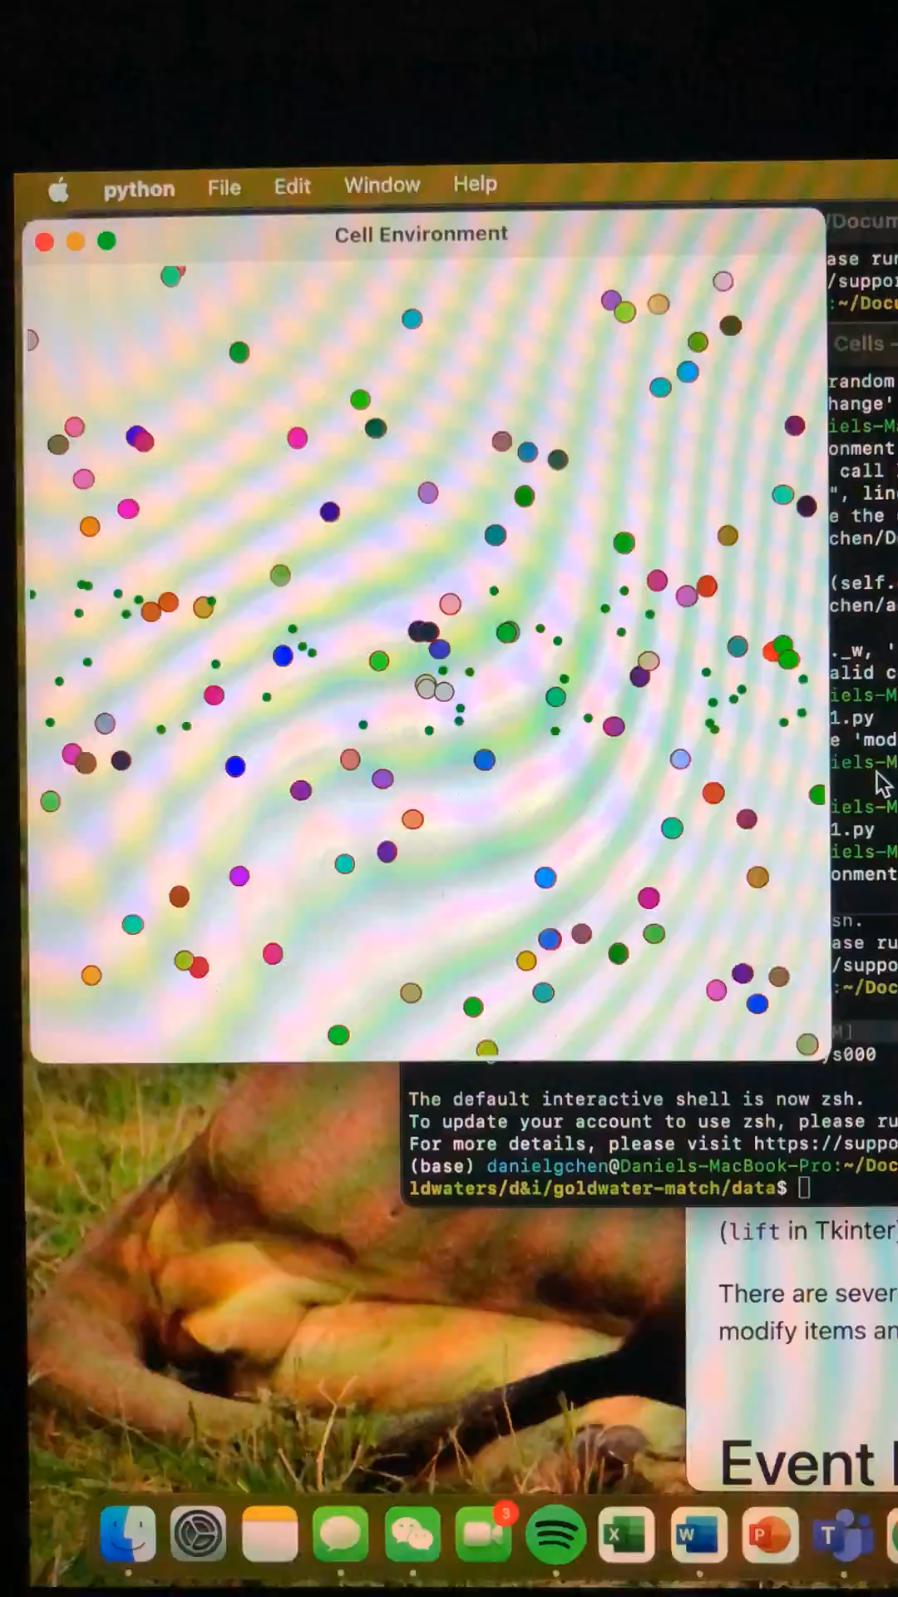
More videos of the same thing

Slide 13
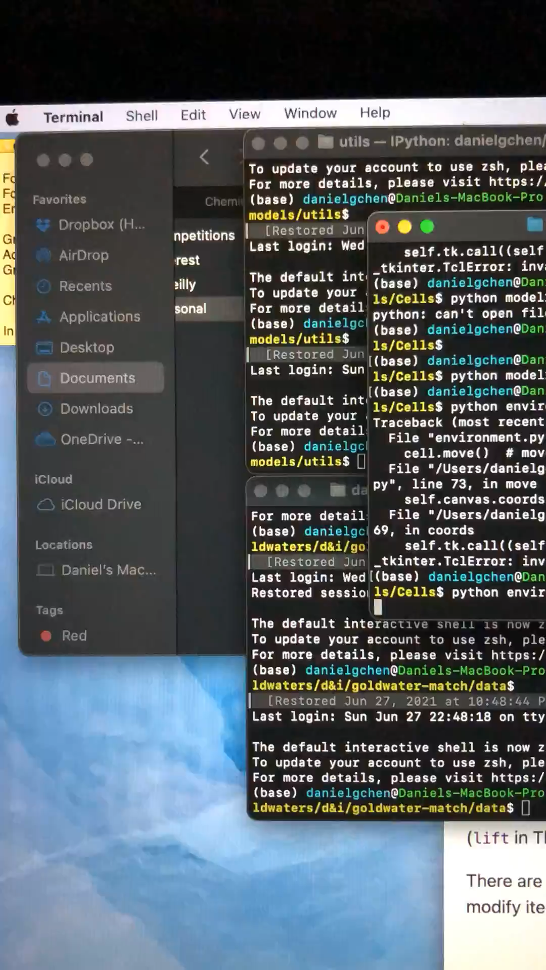
This showed the larger patch of food but the same overall theme is present here

Slide 14
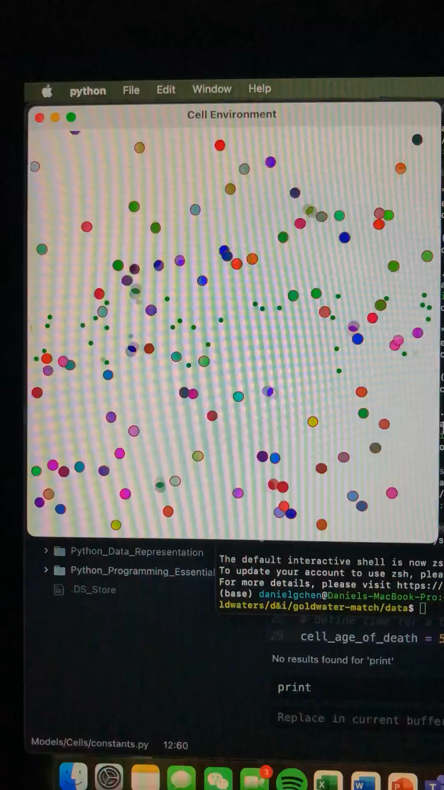
Here’s an example of where mutation allows the cells to move horizontally and you can see wave-like patterns appear this pattern is the few that allows cells not horizontal to start reproducing

Slide 15
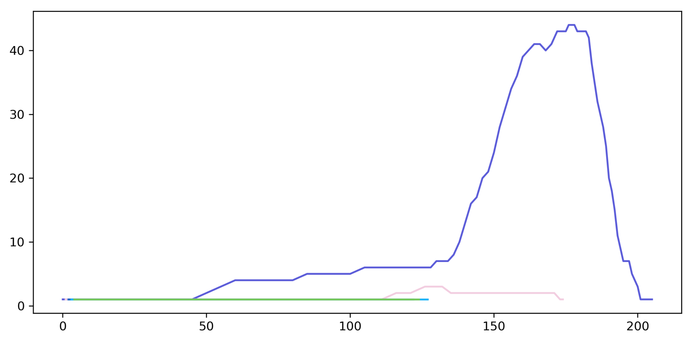
These are population dynamics where the y-axis is the number of cells and the x-axis is the number of rounds which can be thought of as time

Slide 16
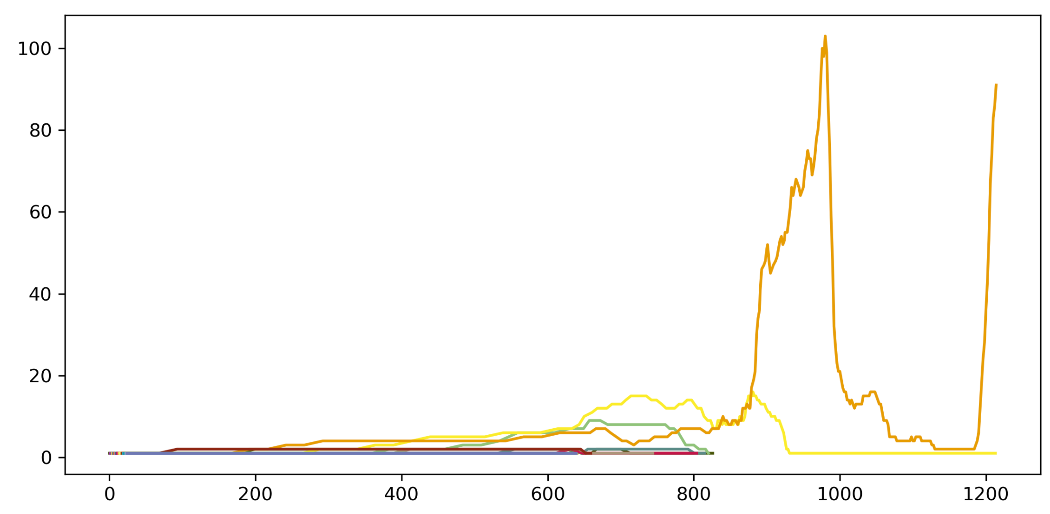
A more complex population dynamic representing boom and bust like cycles

Slide 17
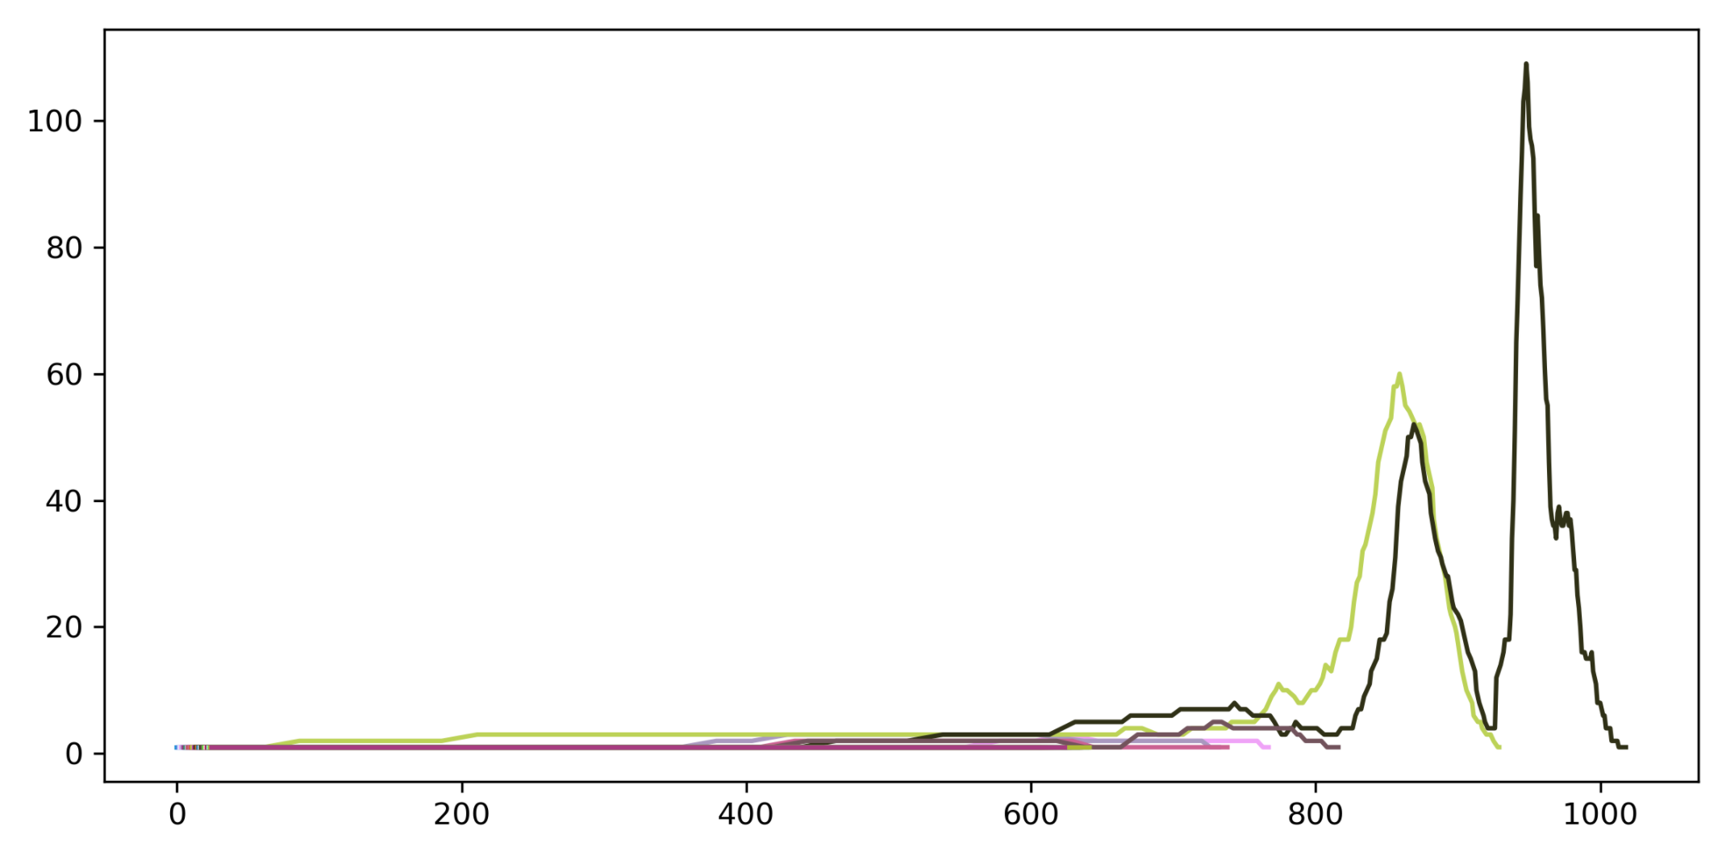
Better boom and bust where we see the dying off of one population setting off or appearing to set off the peak of another population of cells

